Slide 1

WEL- COME TO
BLOOD BANK AND DONOR MANAGEMENT SYSTEM
Under Guidance of
Ass. Prof. Kale S.K.
Group members:
Parit Shrutika
Patil Rutuja
Mane Nilam

Slide 2

One Blood Donation Save three Lives every day
Introduction:
Blood bank and donor management system in PHP can be a great help to patients and hospital in managing efficiently activities such as Donor Registration,receiver and blood transfusion data in the blood bank record and many more.
The Blood Bank & Donor management system is an automated system that is developed using PHP and SQL Server.
Blood Bank and Donor Management system is web-based application.
The Person Who like to donate blood register in the blood bank application.
The person in need of blood search for the preson having the same blood group.

Slide 3
Existing System :
The Operation is tedious,time consuming & Space Consuming
It Create Room For Error as the data is entered manual by the person
It Include the risk of the document being lost over year and maintance of the records is difficult
The data recorded during testing or while accquring the details or different aspect of blood bank management system not so accurite and precise
Maintaning the stock of blood and the daily transaction without computerisation also poses a challenges.

Slide 4
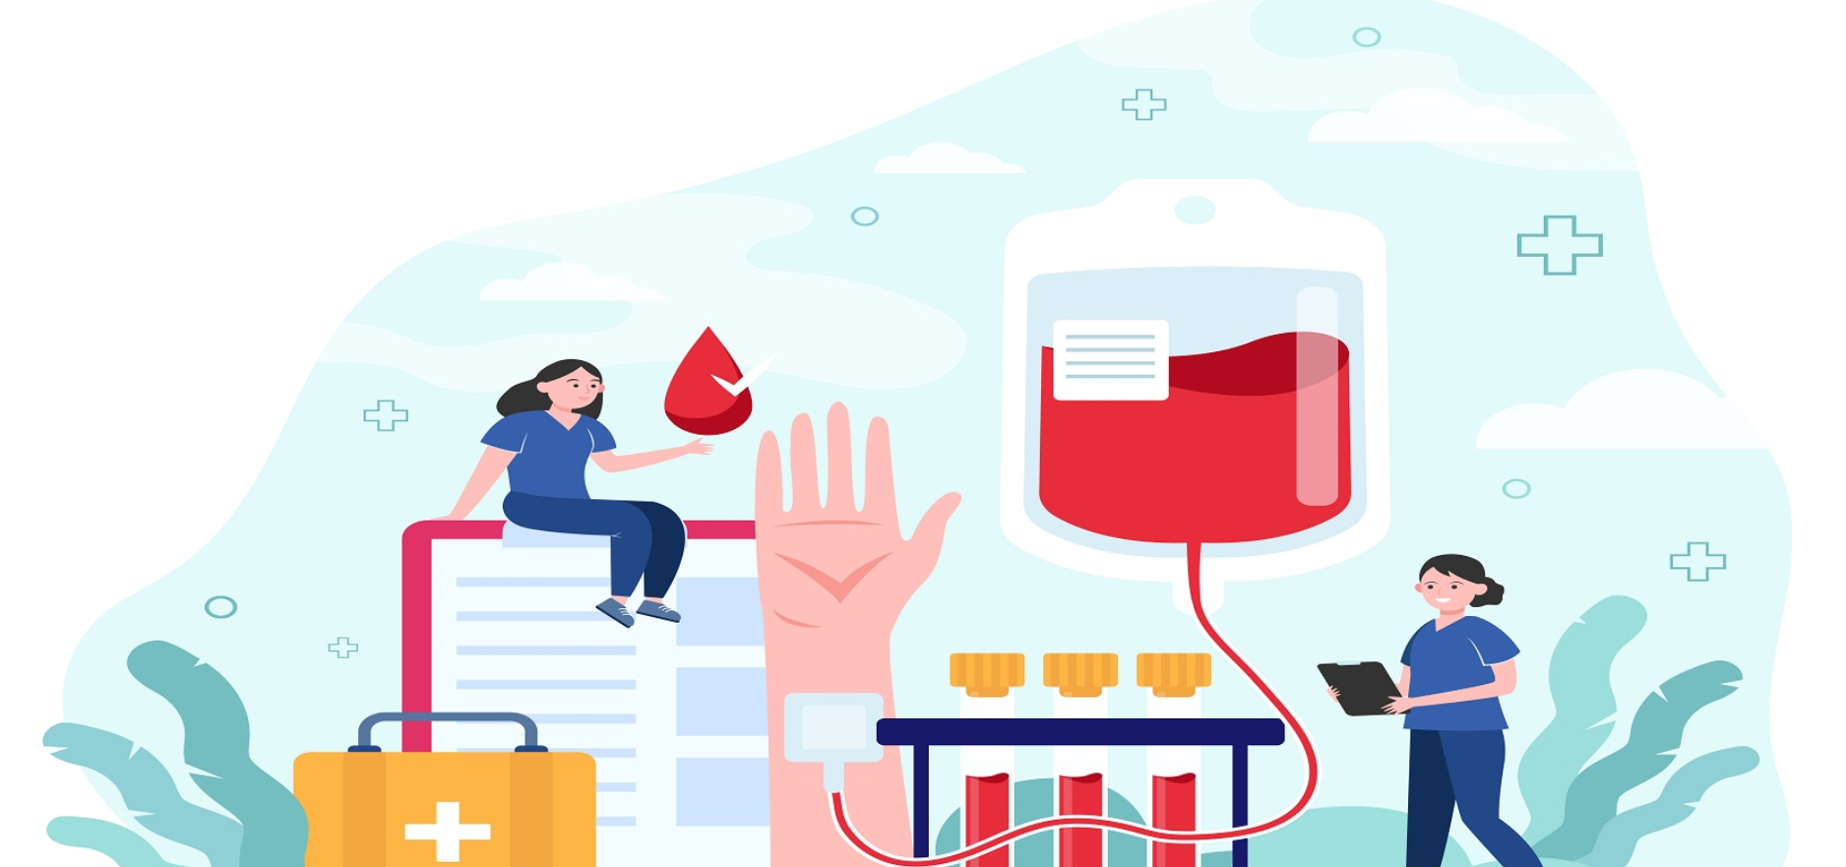
Donate blood ! Give life
Need And Scope in blood bank & donor management system:
The project consists of a central repository containing various blood deposite available along with associated
These details include blood type,storage area and date of storage
The software system in an online blood bank management system that help in managing various blood bank operations effectively
These details include blood type,storage area and date of storage
The project consists of a central repository containing various blood deposits available along with associated

Slide 5
Donate blood give a smile to someone
Objective in blood bank & Donor Management System:
To ensure hospital to have good supply or inventories of blood bags.
To check the availability of blood bags anytime.
To manage the information of its blood donor.
Function to check if the person donate blood for the last 3 months.
To allow good documentation about the donor its blood & Donor activities.
Support fact searching to find match blood bags for the right person.

Slide 6
Data Flow Diagram:
Log in
Insert data
Donor Details
Donor Details
Blood Donor
replay
Response
Insert data
Log in response form
Blood group
Blood Group
replay
Admin
Blood group details
Insert data
Blood Require
Blood requirer
Blood require details
replay
Contact us info
Insert data
Contact us Details
Contact us info
replay
Contact us Query
Insert data
Contact us query details
Contact us Query Details
replay

Slide 7
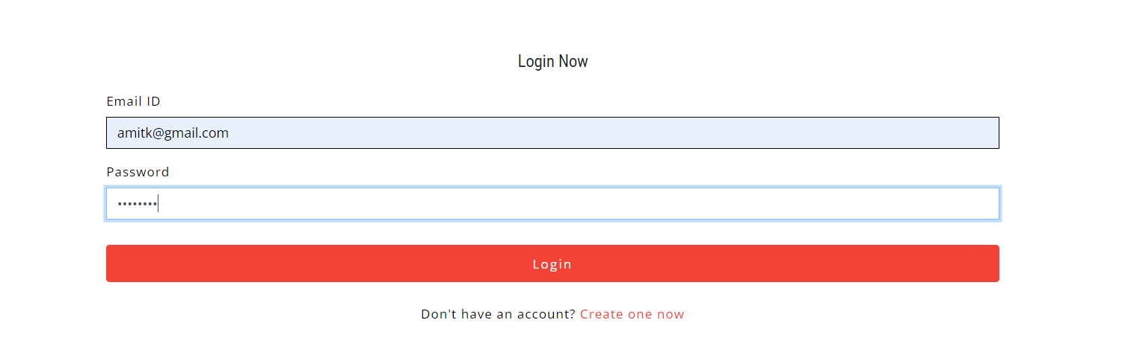
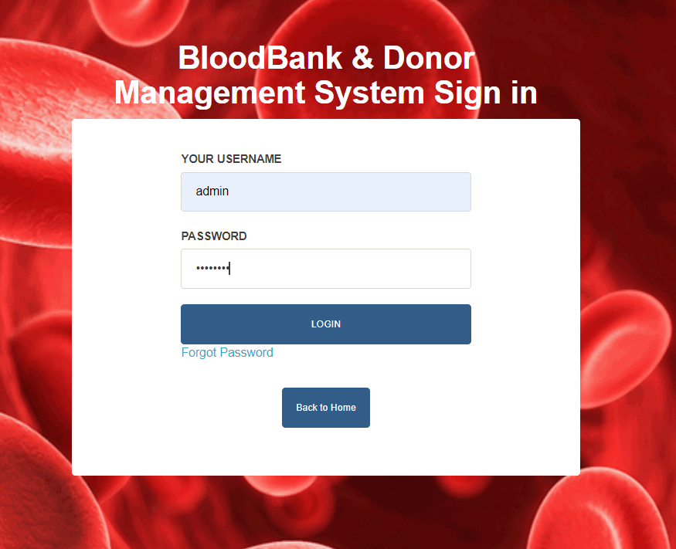
Application Screenshots:
Login
Admin
Blood Donate is a great social work,must do whenever get chance

Slide 8
Conclusion & suggestion:
The purpose of these literature reviews was to collect information on how an information system helped the management of blood banks. Based on the reviews, it was found out that web-based blood bank systems provide convenience, efficiency and security to the system users and hospitals compared to the manual systems.
Suggestion:
1] More report can be added to improve the system.
2] More security features for reports and transactions can be added to the system.
3] Forms for purchase and sale returns can be modified to multi-user system.
4] The system will support online transactions.
5] The system will provide multi-user approach.
6] The system will available in multilanguage.

Slide 9
You can smile to many face through blood donation
Future Enhancement:
1]This System will be linked by internet, so the other hospital can use this data
2]This research study does not cover the actual blood collection activity, and actual blood transfusion operation.
3] we can enhance this system by including more facilities like emergency SMS for donor which ready for blood as well as embedding with hospitals,for Hospital patients facility those who one need blood they can find easy
4] Blood donors and patients or recipients of blood donation are not system users, their registration or information will be encoded by the blood bank receptionists.

Slide 10
Impotance of blood donate:
Donating blood can help other people to maintain good health or allow them to stay alive. There may also be benefits of blood donation for the donor.
One blood donation has the potential to save up to three lives.
Safe blood saves lives.
To Make sure that donated blood and blood product are safe before they are used.
Many people require urgent blood and by donating our blood we easily.

Slide 11
THANK YOU
Lets Contact with us !
9527579423
Helpline no. :- +8585233222
Address :
Krushna hospital,
malkapur karad 415539

